Slide 1
Pygion: Flexible, Scalable Task-Based Parallelism with Python
Elliott Slaughter and Alex Aiken
SLAC and Stanford
Nov. 17, 2019

Slide 2
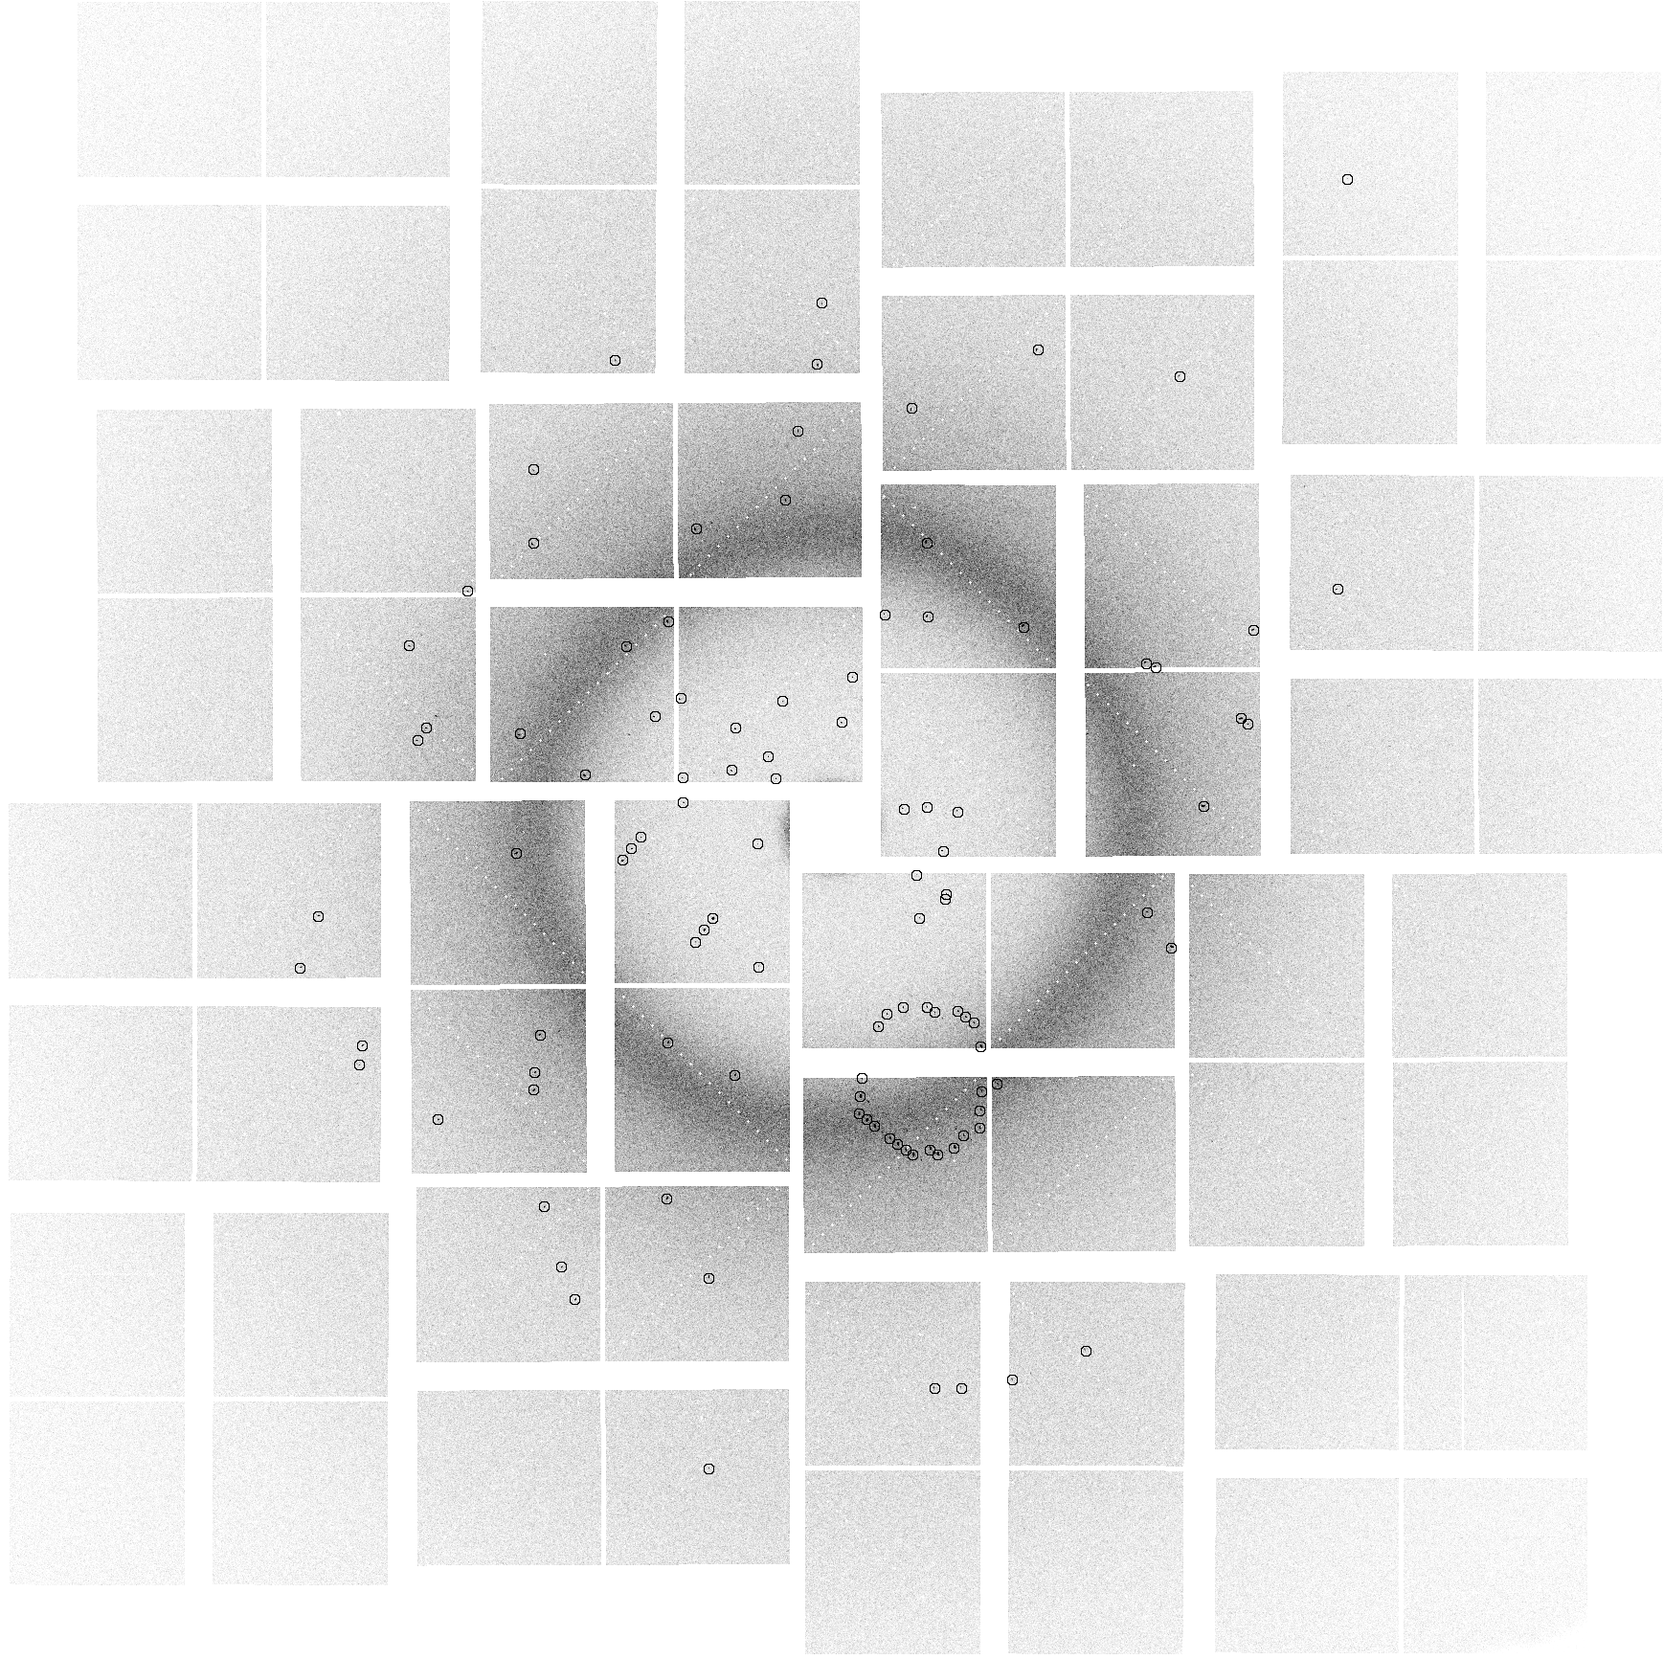
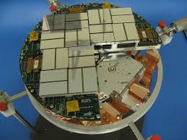
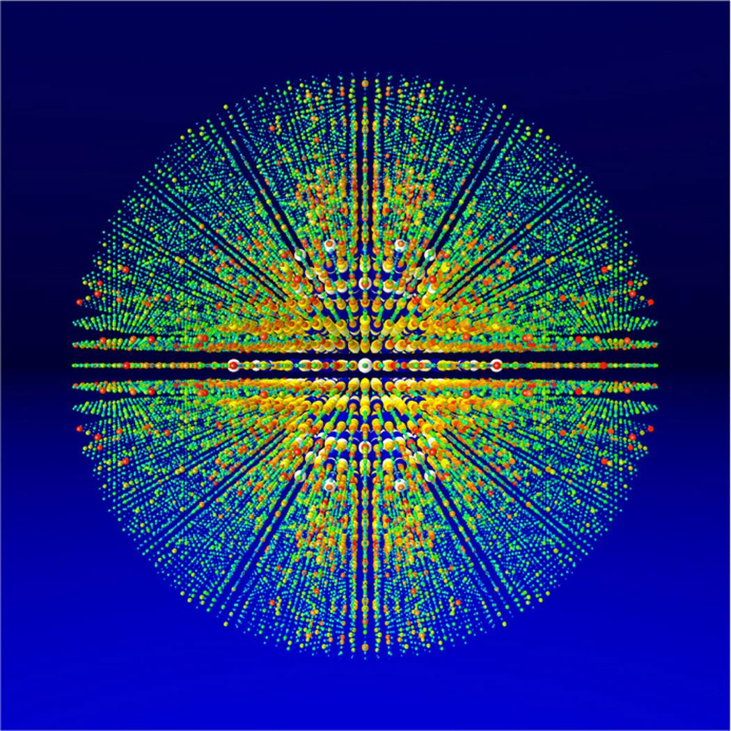
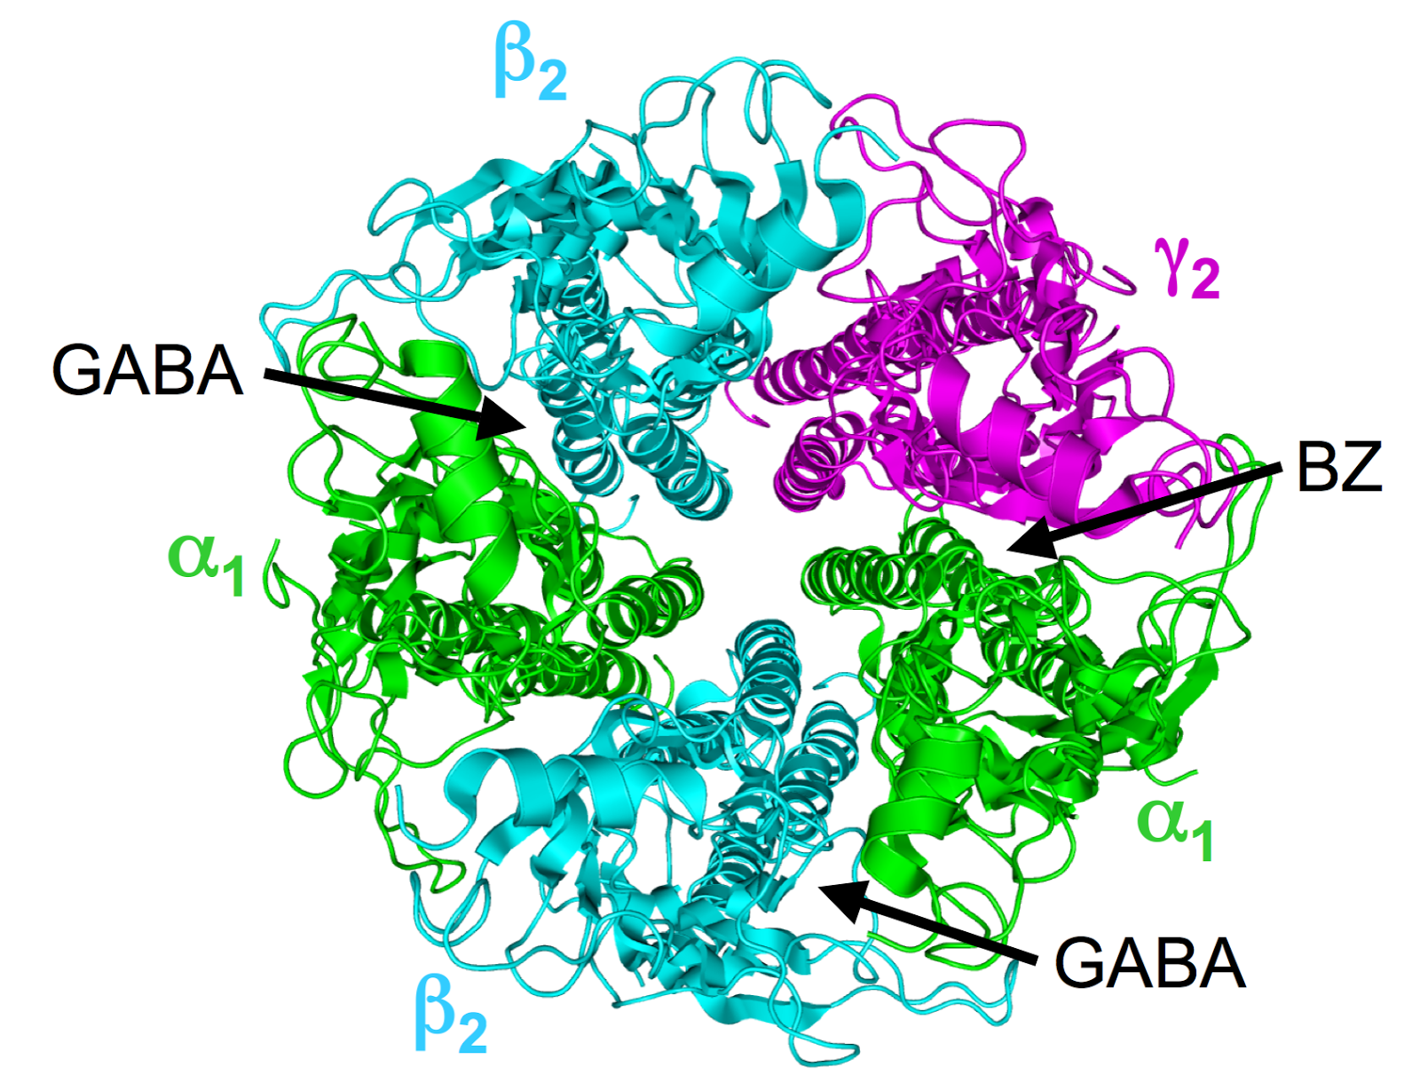
Motivation: Data Analysis at LCLS
Experiments are high stakes
Novel science in every experiment
Code written, debugged, executed on the fly
Users are not expert performance programmers
“What’s a Linux?”
Future upgrade to ~100 GB/s data rate, requires supercomputers
How can users productively, performantly program these machines?
detector
x-ray diffraction image
reconstructed electron
density
intensity map

Slide 3
Pygion: Task-Based Programming for Python
Task-based models are a promising direction
Sequential semantics, parallelism discovered automatically
Recent advances make scalability painless (see SC’19 talk on Legate)
But how to program?
Legion C++ ([SC’12]): large, complex API, error prone
Regent (language for Legion [SC’15]): better, but still static
Python (this paper)
We show that task-based models can be implemented efficiently for Python
[SC’12]: Legion: Expressing Locality and Independence with Logical Regions, M. Bauer et al.
[SC’15]: Regent: A High-Productivity Programming Language for HPC with Logical Regions, E. Slaughter et al.

Slide 4
Performance: Can it Possibly be Reasonable?
Yes!
Key insight: control code (that launches tasks) is not on the critical path
What matters is the average rate of task launches vs execution
If you can stay ahead (rate of launch > rate of execution), performance will be good
Second insight: use dynamic analysis to perform optimizations
Out of 7 Regent optimizations, 5 work in Pygion, 1 irrelevant
In our experiments Pygion is able to achieve within 3% of Regent at all node counts (up to 512 nodes)

Slide 5
Regions and Partitions
S = Region([10], {'x': float, 'y': float})
P = Partition.equal(S, [2])
keys
0
1
2
3
4
5
6
7
8
9
 | fields
 | x | y
P[0]
P[0]
S
P[1]

Slide 6
Tasks
def saxpy(S, a):
S.y += a * S.x
S = Region([10], {'x': float, 'y': float})
P = Partition.equal(S, [2])
for i in range(2):
saxpy(P[i], 1.23)
@task
@task(privileges=[RW('y') + R('x')])

Slide 7
Dependence Analysis
S = Region([10], ...)
P = Partition.equal(S, [2])
Q = Partition.equal(S, [3])
for t in range(10):
for i in range(2):
saxpy(P[i], 1.23)
for j in range(3):
step(Q[i], 3.45)
saxpy(P[0])
saxpy(P[1])
step(Q[0])
step(Q[1])
step(Q[2])
saxpy(P[0])
saxpy(P[1])
step(Q[0])
step(Q[1])
step(Q[2])

Slide 8
Code Comparison: Pygion vs Legion C++
@task(privileges=[RW('y')+R('x')])
def saxpy(S, a):
S.y += a * S.x
S = Region([10], {
'x': float, 'y': float})
P = Partition.equal(S, [2])
for i in IndexLaunch([2]):
saxpy(P[i], 1.23)
enum FIELD_IDS { FID_X, FID_Y };
enum TASK_IDS { TID_SAXPY, TID_MAIN };
void saxpy(const Task *task, const std::vector<PhysicalRegion> &regions,
Context ctx, Runtime *runtime) {
FieldAccessor<READ_WRITE,float,1> acc_y(regions[0], FID_Y);
FieldAccessor<READ_WRITE,float,1> acc_x(regions[1], FID_X);
float a = *(const float*)(task->args);
Rect<1> rect = runtime->get_index_space_domain(
ctx, task->regions[0].region.get_index_space());
for (PointInRectIterator<1> i(rect); i(); i++)
acc_y[*i] += + a * acc_x[*i];
}
void main(const Task *task, const std::vector<PhysicalRegion> &regions,
Context ctx, Runtime *runtime) {
IndexSpace I = runtime->create_index_space(ctx, Rect<1>(0, 9));
FieldSpace F = runtime->create_field_space(ctx);
FieldAllocator allocator = runtime->create_field_allocator(ctx, F);
allocator.allocate_field(sizeof(float), FID_X);
allocator.allocate_field(sizeof(float), FID_Y);
LogicalRegion S = runtime->create_logical_region(ctx, I, F);
IndexSpace colors = runtime->create_index_space(ctx, Rect<1>(0, 1));
IndexPartition IP = runtime->create_equal_partition(ctx, I, colors);
LogicalPartition P = runtime->get_logical_partition(ctx, S, IP);
float a = 1.23;
IndexLauncher launch(TID_SAXPY, colors, TaskArgument((void *)&a, sizeof(a)),
ArgumentMap());
launch.add_region_requirement(RegionRequirement(
P, 0, READ_WRITE, EXCLUSIVE, S));
launch.add_region_requirement(RegionRequirement(
P, 0, READ_ONLY, EXCLUSIVE, S));
launch.add_field(0, FID_Y);
launch.add_field(1, FID_X);
runtime->execute_index_space(ctx, launch);
}

Slide 9
Pygion is Higher-Level than Legion
Feature | Pygion | Legion
Privilege tracking | Automatic | Manual
Memory management (for regions, etc.) | Automatic (via dynamic escape analysis) | Manual
Accessors (for efficient data access) | Automatic (via NumPy) | Manual
Calling convention | Automatic (Pickle or Regent) | Manual
See paper for details

Slide 10
Optimizations in Pygion
Optimizations are critical to achieving performance
Out of 7 Regent optimizations, 5 work in Pygion, 1 irrelevant
Optimization | Pygion | Regent
Index Launches | Yes (more on this later) | Yes
Futures | Yes | Yes
Mapping | Yes | Yes
Pointer Check Elision | Yes | Yes
Vectorization | Yes | Yes
Dynamic Branch Elision | Irrelevant | Irrelevant
Leaf/Inner | No | Yes
Also: control replication [SC’17, SC’19] is provided by Legion, enables scalability
See paper for details

Slide 11
Index Launch Optimization
for i in range(2):
saxpy(P[i], 1.23)
index_launch(
[2], saxpy, P[ID], 1.23)
Normal Task Launch
O(N) time to enumerate tasks
O(N) runtime analysis
Limited scalability
Constant Time Launch (CTL)
O(1) time to enumerate tasks
O(1) runtime analysis
Superior scalability

Slide 12
Constant Time Launch (CTL) Desugared
Original Code:
index_launch(
[2], saxpy, P[ID], 1.23)
Good: One API call into Legion
Good: Python code is O(1)
Meh: Symbolic loop variable
After Optimization:
P_ID = SymbolicAcess(
P, SymbolicIndex(“ID”))
launch = IndexLaunch([2])
launch.execute(
saxpy, P_ID, 1.23)

Slide 13
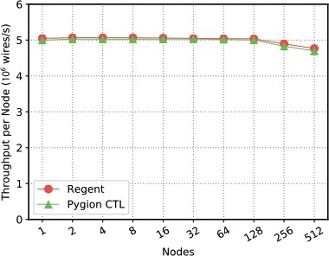
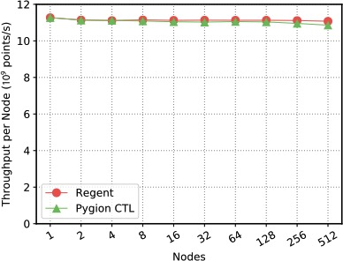
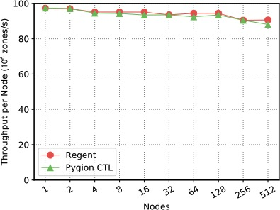
Evaluation
Piz Daint: Cray XC50, Intel Xeon E5-2690 v3 and NVIDIA Tesla P100 per node.
Three already optimized applications, weak scaling up to 512 nodes for each application. Used original, optimized Regent GPU kernels for apples-to-apples comparison.
Circuit
Stencil
Pennant
Performance is within 3% of Regent at all node counts.

Slide 14
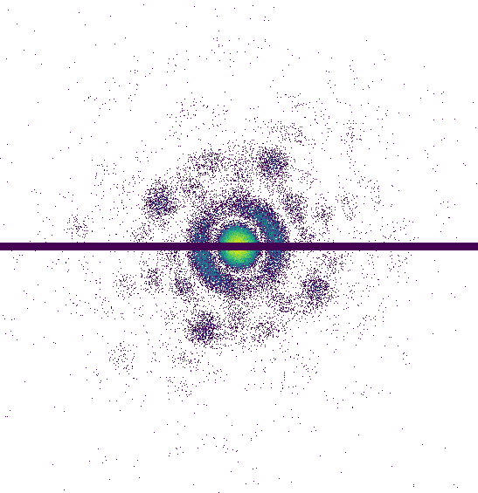
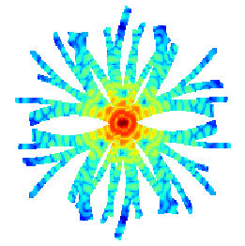
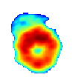
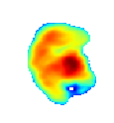
Case Study: MiniFEL Proxy Application for ExaFEL
ExaFEL is an ECP project to develop exascale capability for LCLS data analysis
MiniFEL is the first ExaFEL proxy application
Written in Pygion, primarily by domain scientists
Easy-to-use interface enabled productive development
Data Collection
Feed
CPU
Preprocessing
Accumulates
Reconstructions
Reconstructions
GPU
(+ CPU)
Reconstructions
Iterate
Reconstructions

Slide 15
Acknowledgment
This material is based upon work supported by the Exascale Computing Project (17-SC-20-SC), a collaborative effort of the U.S. Department of Energy Office of Science and the National Nuclear Security Administration, and by a grant from the Swiss National Supercomputing Centre (CSCS) under project ID d80.

Slide 16

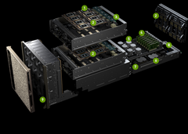
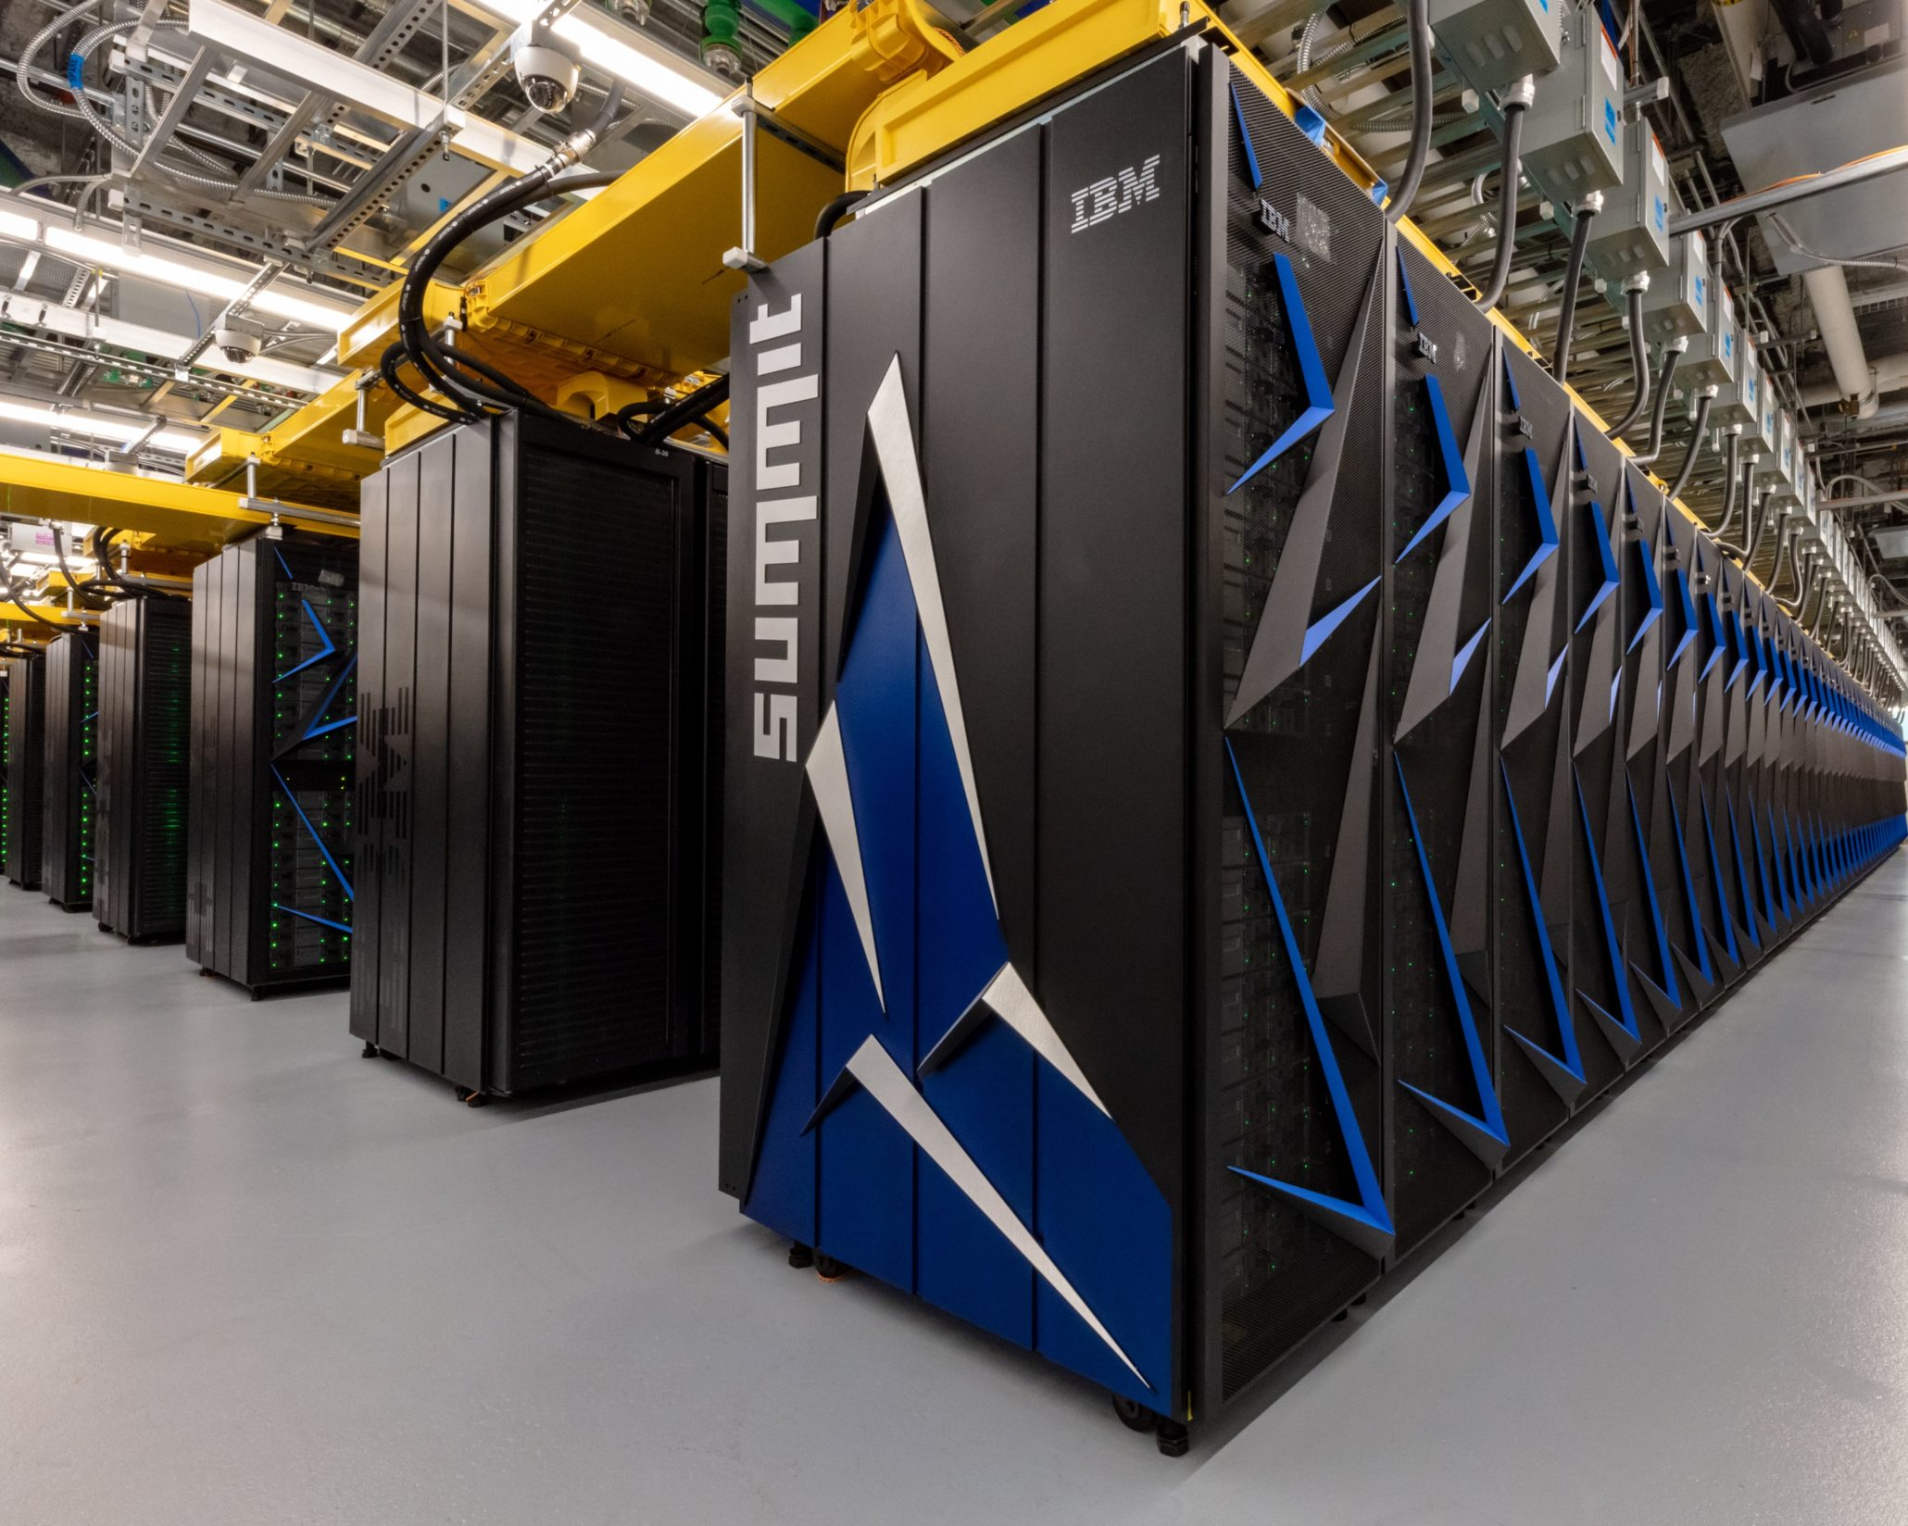
Questions
You might also be interested in….
Legate NumPy is a drop-in NumPy replacement for transparent scaling
Requires only a one line code change
Same code runs on everything
Powered by Legion just like Pygion
Uses Legion’s control replication optimization for scalability
Technical Paper Presentation:
Tuesday 4:30-5pm, 301-302-303
import legate.numpy as np
def cg_solve(A, b, tol=1e-10):
x = np.zeros(A.shape[1])
r = b - A.dot(x)
p = r
rsold = r.dot(r)
for i in xrange(b.shape[0]):
Ap = A.dot(p)
alpha = rsold / (p.dot(Ap))
x = x + alpha * p
r = r - alpha * Ap
rsnew = r.dot(r)
if np.sqrt(rsnew) < tol:
break
beta = rsnew / rsold
p = r + beta * p
rsold = rsnew
return x

